Slide 1
Project Dijkstra (yes, we spelt it correctly)
Dijkstraaaaaaaaaaa
Yap Shen Hwei
Nicholas Png
Marcus Soh
Vignesh

Slide 2
Content Page
Adjacency Matrix + Array (Time Complexity)
Adjacency List + MinHeap (Time Complexity)
Our Implementation
Sparse vs Dense Graph (Theoretical)
Empirical Trends
Array + AdjMatrix vs MinHeap + AdjList
Conclusion

Slide 3
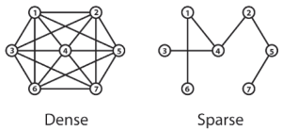
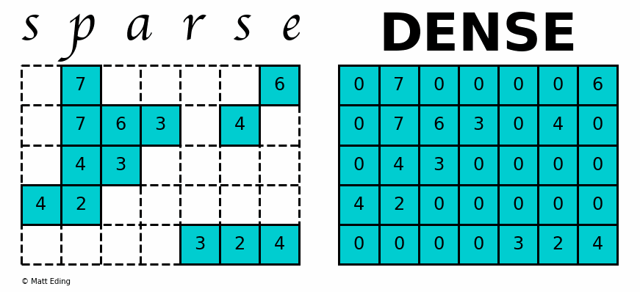
Sparse & Dense Graph Definition
Sparse graph is a graph in which the number of edges is close to the minimal number of edges - sparsely connected
|E| = |V|
Binary trees
Can exist as a disconnected graph
Dense graph is a graph in which the number of edges is close to the maximal number of edges - densely connected
|E| = |V| * |V-1| = |V|²
Complete graph
Notes:
Informally, a graph with relatively few edges is sparse, and a graph with many edges is dense.
Definition (Sparse Graph): A sparse graph is a graph G = (V, E) in which |E| = O(|V|). Therefore adjacency lists are preferred since they require constant space for every edge.
Definition (Dense Graph) A dense graph is a graph G = (V, E) in which |E| = Θ(|V|2). Therefore adjacency matrix is preferred.
This is not exactly (n²), but very close to it. You can say that n² is an upper bound, so it is maybe more appropriate to say O(n²) if that makes sense in the context.
To give a comparison, let us assume graph has 1000 vertices.
Irrespective of whether the graph is dense or sparse, adjacency matrix requires 1000^2 = 1,000,000 values to be stored.
If the graph is minimally connected (i.e. it is a tree), the adjacency list requires storing 2,997 values. If the graph is fully connected it requires storing 3,000,000 values.

Slide 4
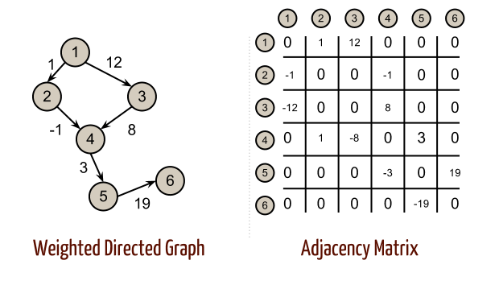
Time Complexity: Adjacency Matrix + Array
 | Time Complexity
Extract cheapest vertices for processing | Number of Vertices * (Extract next cheapest node + Relaxation of nodes) = O(|V|) * [O(|V|) + O(|V|)] = O|V|²
Update Shortest Distance | Number of Edges * Update array = O(|E|) * O(1) = O(|E|)
Overall | O(|V|² + |E|) = O(|V|²)

Slide 5
Time Complexity: Adjacency List + MinHeap
 | Time Complexity
Heapify | O(log|V|)
Extract Vertex from Heap | Number of vertices * Cost of extracting root node = O(|V|) * [O(log|V|) * O(1)] = O(|V| * log|V|)
Updating Path Cost | Number of edges * Cost of updating = O(|E|) * O(log|V|) = O(|E| * log|V|)
Overall | O(|E|log|V| + |V|log|V| + log|V|) = O([|E| + |V|] *log|V|)

Slide 6
Theoretical Best Case
Sparse Graph → |E| = |V| - 1
 | Adjacency Matrix + Array | Adjacency List + MinHeap
Time Complexity (Formulae) | |V|² | |E| log |V|
Vertices | 1024 | 1024
Edges | 1023 | 1023
Time Complexity | 1,047,552 | 3079

Slide 7
Theoretical Worse Case
Dense Graph → E = V x (V - 1)
 | Adjacency Matrix + Array | Adjacency List + MinHeap
Size of Priority Queue | |V|² | (|E|+|V|)*log |V|
Vertices | 1024 | 1024
Edges | 1,047,552 | 1,047,552
Time Complexity | 1,048,576 | 3,156,528

Slide 8
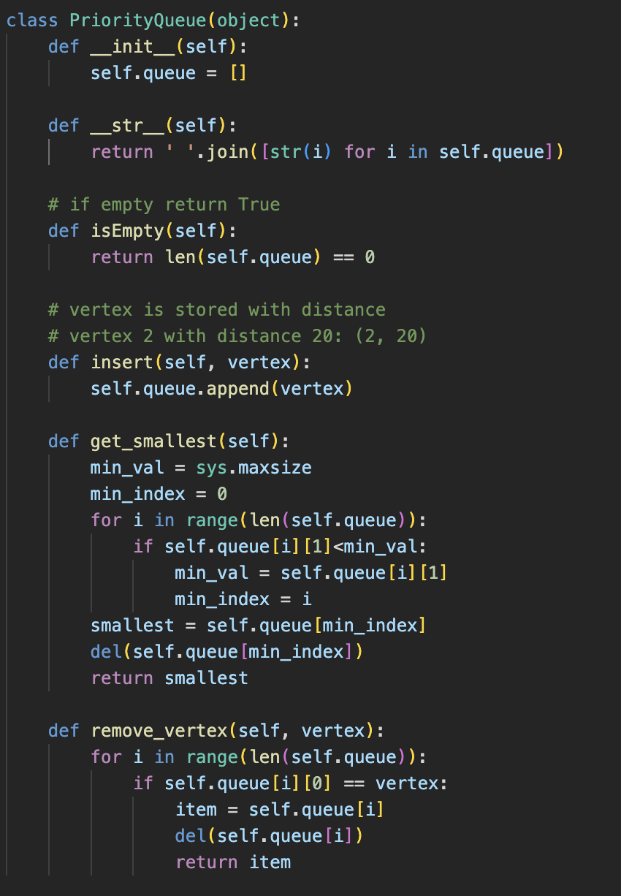

Our Implementation: PriorityQueue() using Array

Slide 9
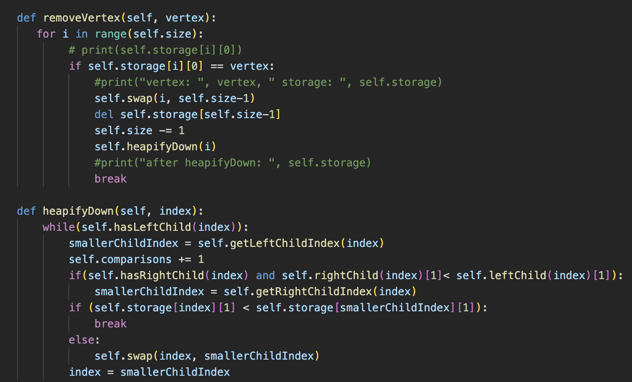
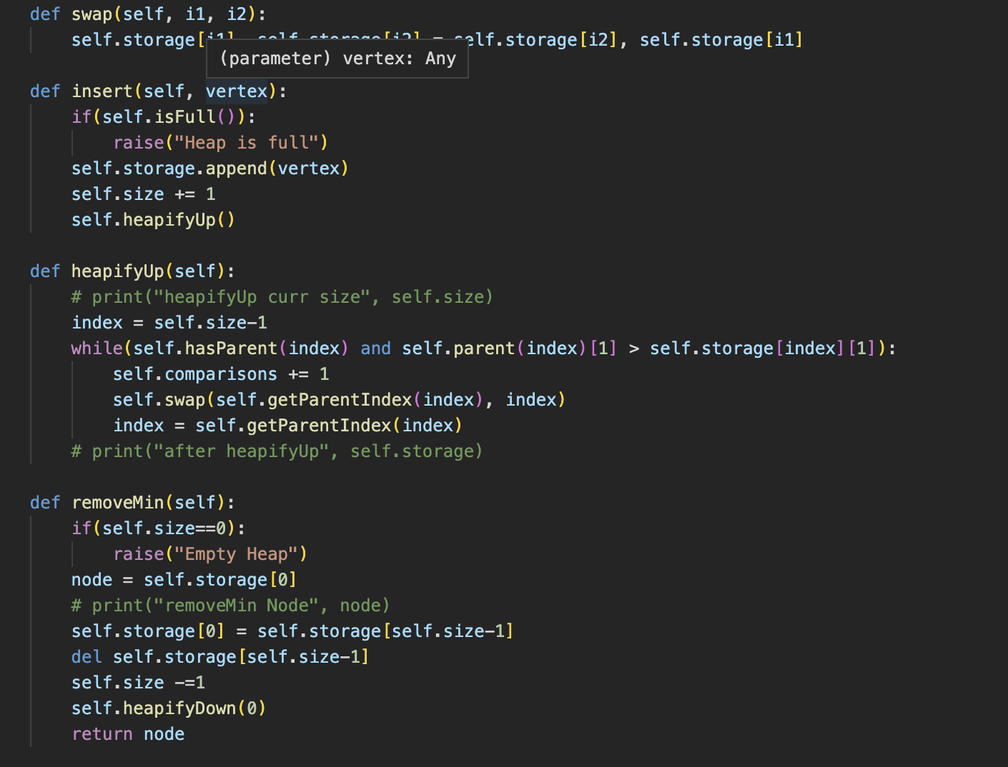
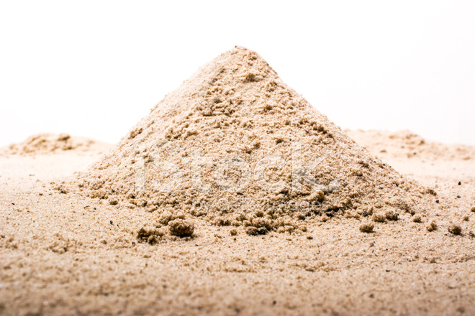
Our Implementation: Heap()

Slide 10
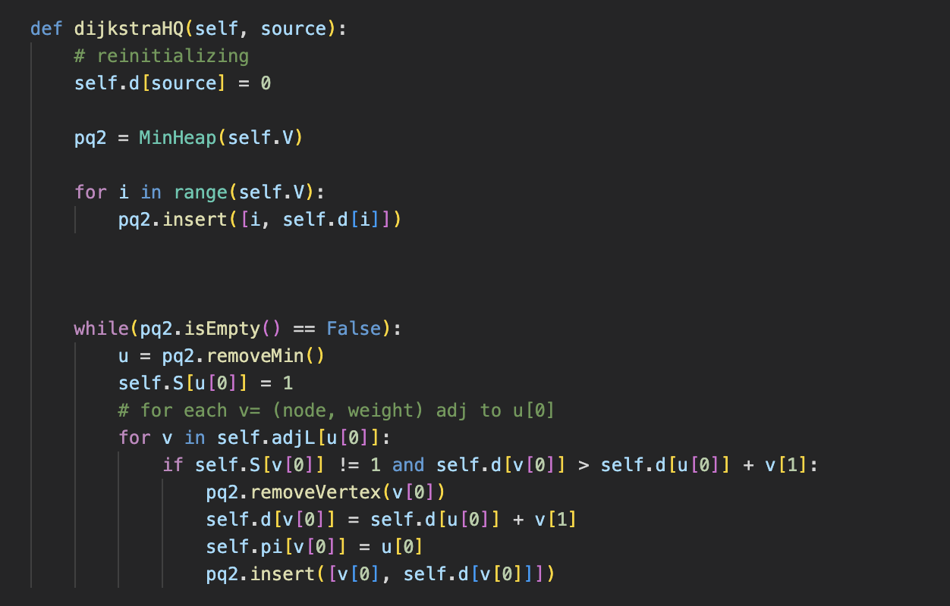
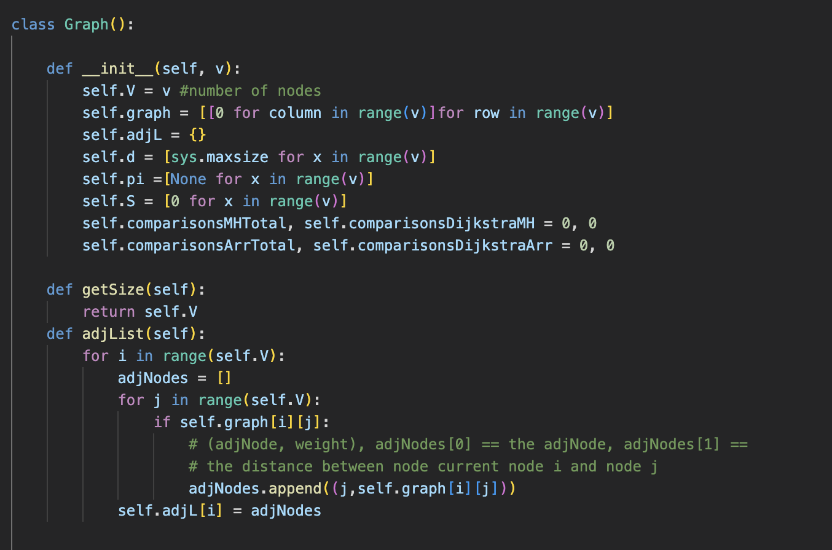
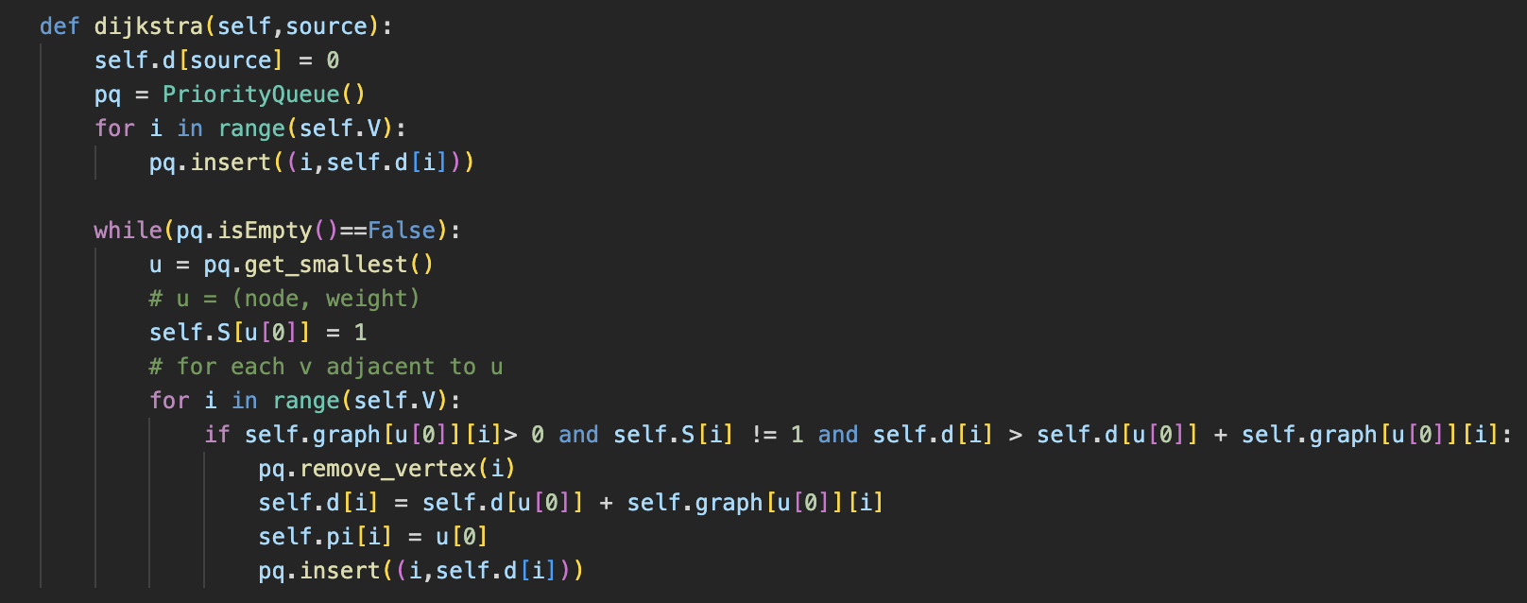
Our Implementation: Graph()
For when using Heap
For when using Priority Queue (Array)

Slide 11
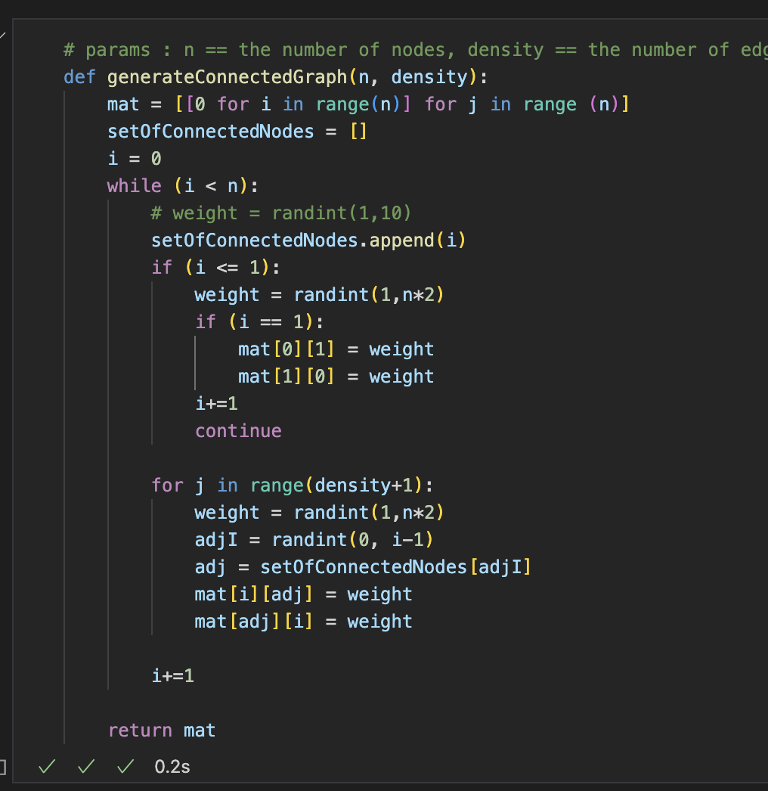
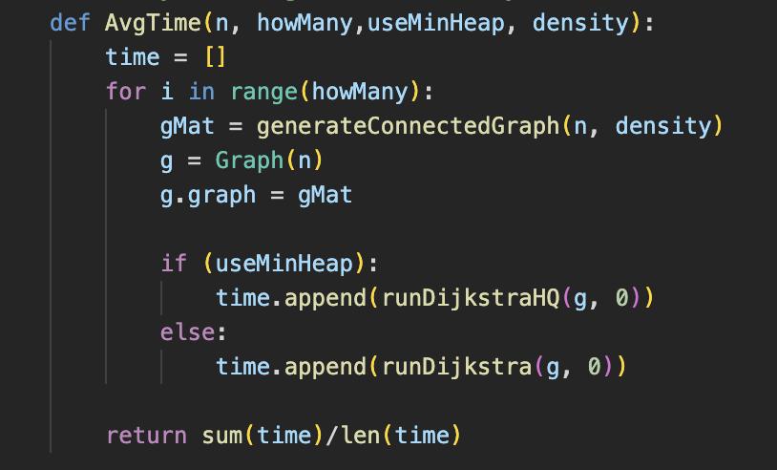
Our Methods: Important Functions
Generate Connected Graphs
This function allows you to change the density of graph, such that each node can be connected to at most a certain number (density) of other nodes.
Note that the density < number of nodes, because one node can have at most V-1 edges!
Average Time Calculation
Important to obtain averages of the same case, but different graphs.
Notes:
To obtain average is important

Slide 12
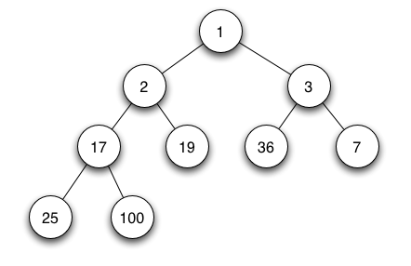
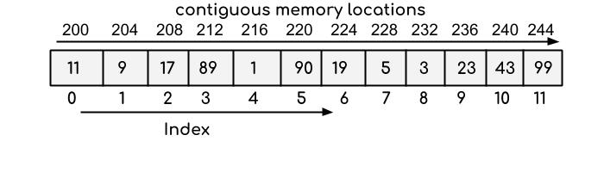
Array vs MinHeap

Slide 13
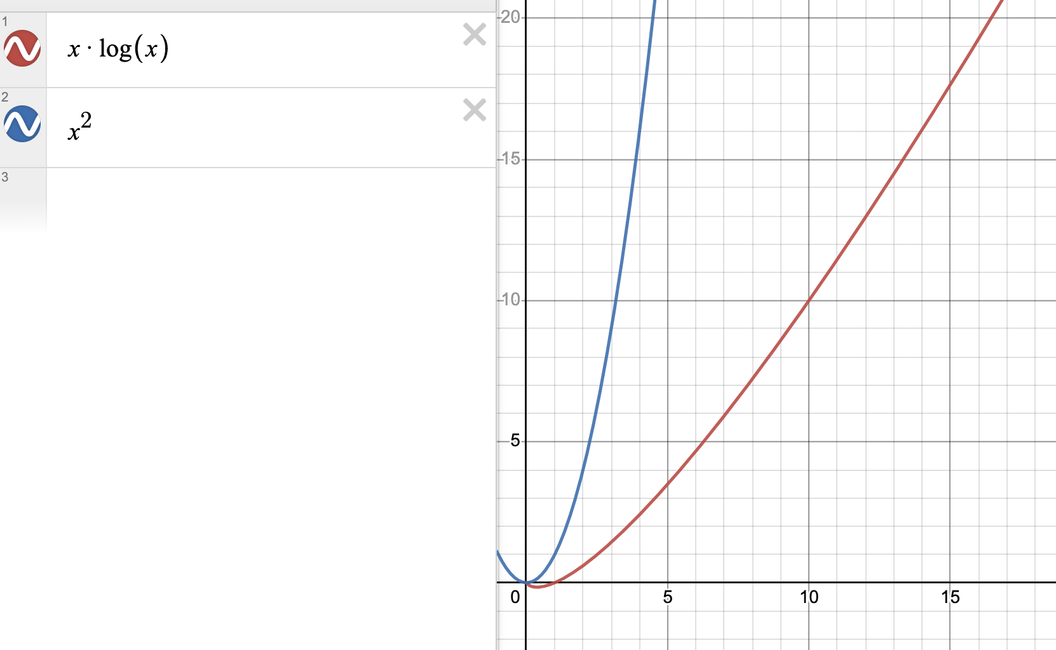
It follows the general trend

Slide 14
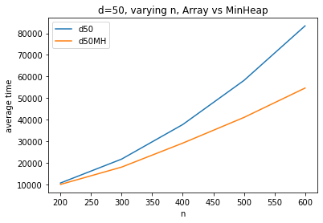
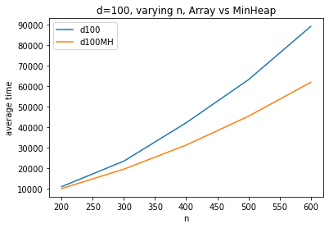
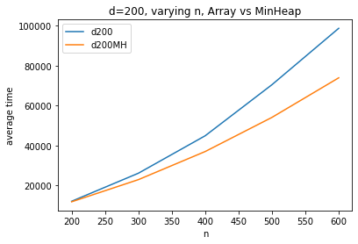
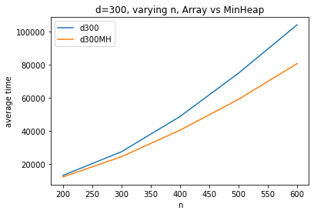
Array vs MinHeap, varying n
Notes:
Conclusions that we can draw for these data points is that MinHeap is generally the faster implementation with increasing number of nodes

Slide 15
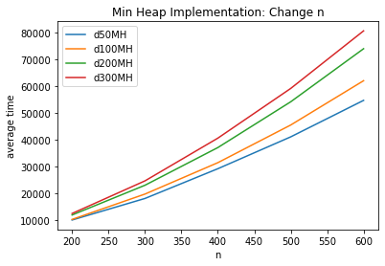
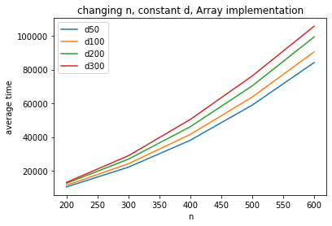
Empirical Trends: Changing n, constant densities
d = 50, 100, 200, 300
Array, adjMat
Min Heap, adjList
Notes:
Both array and minheap are growing as expected from the theoretical. The graph also shows that at higher densities, the time taken is higher.

Slide 16
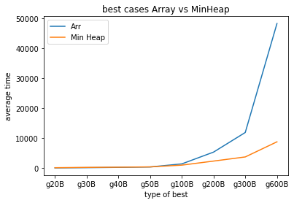
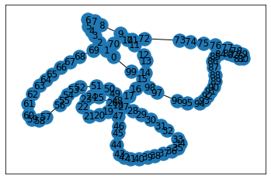
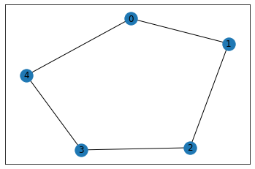
The best case for MinHeap?
Rate of growth in average time much much lower using Minimum Heap for sparse graph
Reasoning: Using adjacency list, we only need to loop through the adjacent nodes, not all the nodes.
Notes:
We theorize that the best case for Min Heap is when the graph has as little edges as possible. So it would probably look something like this. Our empirical results agree to this assumption.
Rate of growth in average time much much lower using Minimum Heap.
Reasoning: Using adjacency list, we only need to loop through the adjacent nodes, not all the nodes.

Slide 17
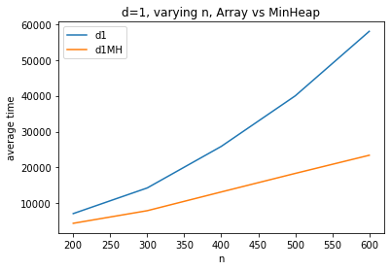
The case of d = 1:
Sparse connected graph
We can observe that MinHeap performs better when the graph is sparsely connected

Slide 18
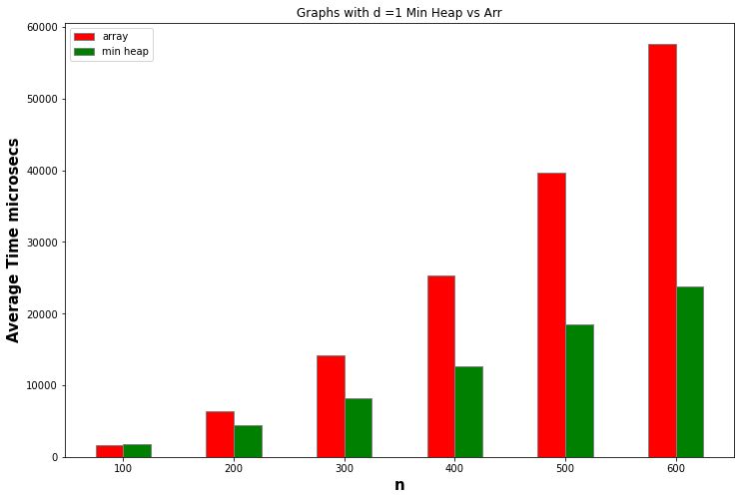
What if it was sparse in general?
Notes:
CPU runtime is faster because the adjacency list is not a exponential loop of n^2

Slide 19
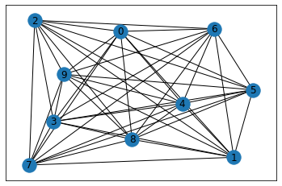
The best case for Array?
We would expect that complete graphs will be the best cases for adjacency matrix (& using Array)

Slide 20
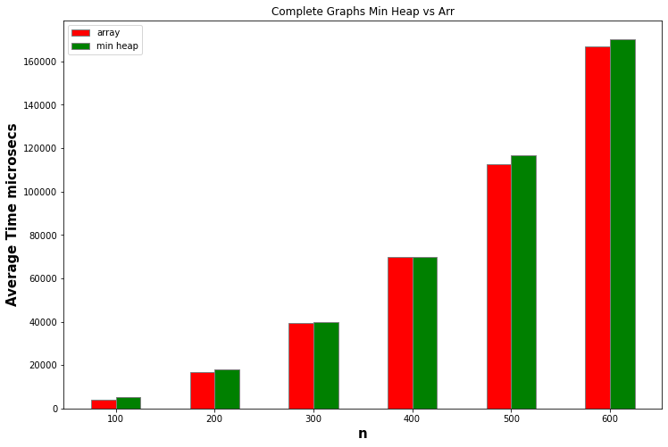
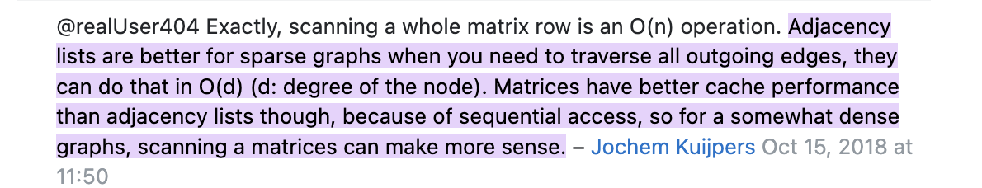
Using Array Performs Better: Complete Graphs
Because array implementation uses AdjMatrix, and Matrices have better cache performance.
(according to Stack Overflow)
Notes:
Generally, for complete graphs, adjacency list and array performs better than using matrices. This is because, according to Stack Overflow…. Even though the complexity of Array implementation is higher, the better cache performance may favour array implementation for very dense / complete graphs.

Slide 21
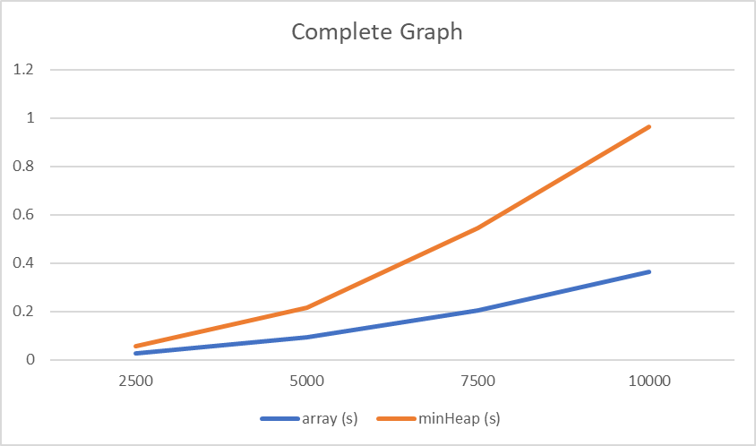
Using Array Performs Better: Complete Graphs (in C)
C implementation
Notes:
We also confirmed our statistics obtained from C program, since the previous statistics look like the difference was not very obvious. It shows a greater difference

Slide 22
Conclusion
If the graph is dense and compact → Complete graph
Use Adjacency Matrix with Array as Priority Queue
If the graph is sparse and less compact → Incomplete graph
Use Adjacency List with MinHeap as Priority Queue

Slide 23
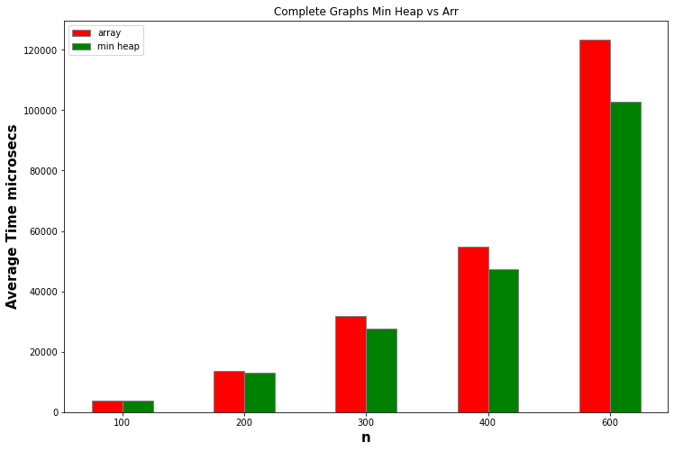
Some other findings and thoughts
Using numpy matrix to represent our AdjMatrix may make operations faster (in the context of Python)
The variation in weights also affects performance.
This is because by mistake, we randomly generated weights only from [1,10]
This may suggest that the dijkstra takes longer to find the shortest path because the difference between values may be very small and therefore, when you pick from the queue, there are high chances that you have to explore more nodes.
Our array implementation showed worse performance (weights [1,10]) highly because the advantage in better cache performance was masked by the better O(ElogV) of the MinHeap Implementation.
CPython!

Slide 24
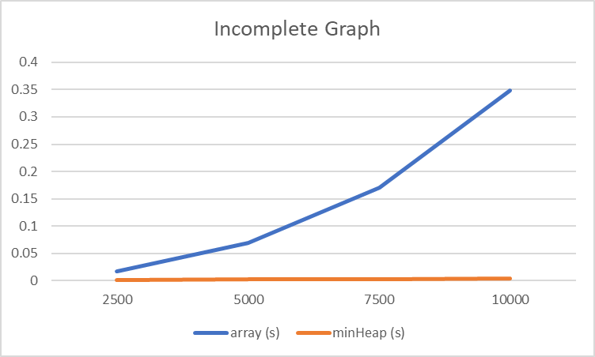
Incomplete Graphs (in C)
C implementation

Slide 25
Thank you :)

Slide 26
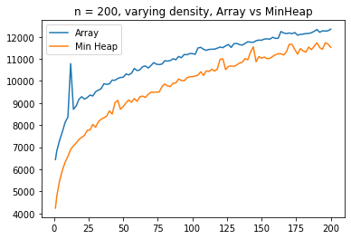
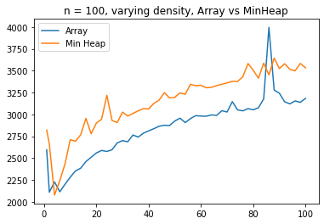
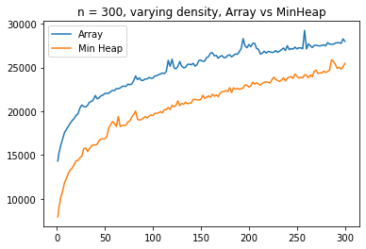
Array vs MinHeap, varying density

Slide 27
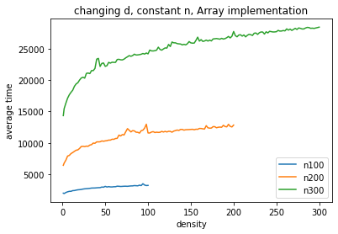
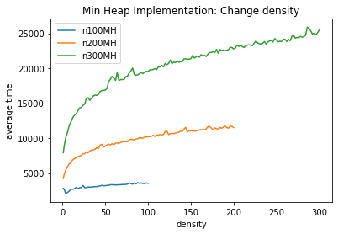
Changing Density, Constant n for n = 100,200,300
Array, using adjMatrix
MinHeap, using adjList

Slide 28
Initially, we got our results as this:
This seems incorrect, because
Complete graphs theoretically favours Array Implementation
INCORRECT RESULTS, REASON NEXT SLIDE

Slide 29
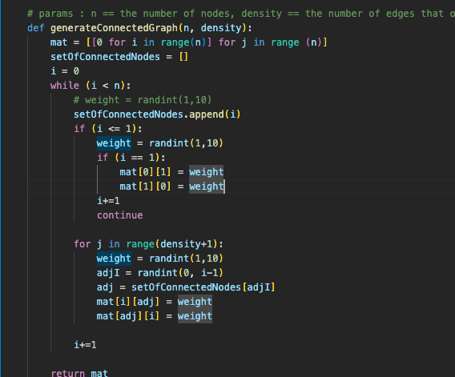
Found the problem! Range of Weights too small!
The range of random integers too small.
Therefore, there are many repeats of the same weight
This case may favour min heap implementation more, because it’s likely to make the search

Slide 30
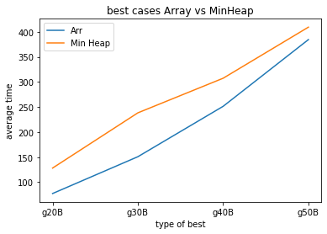
BUT if we zoom in
We can observe that the Array performs slightly better.
This may suggest that the

